Slide 1
Traffic Classification and Monitoring

Slide 2
Anything here?
Traffic classification is a process which categorises the computer network traffic based on various parameters.
These parameters include port numbers, protocols etc.
Various open source tools are available to monitor and classify network traffic

Slide 3
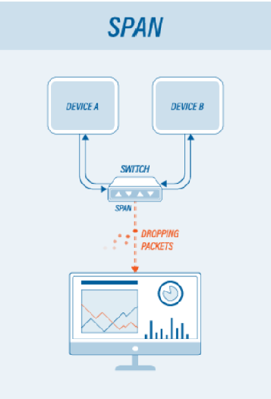
Monitoring network traffic:
There are two methods to monitor network traffic:
Mirrored ports ( SPAN - Switch Port Analyzer )
Network Tap ( Terminal port Access )
Mirrored Ports :
SPAN or roving analysis is a method for observing network traffic in a non-intrusive manner.
It is a software feature built into a network switch or a router that creates a copy of selected packets passing through device and sends them to a designated mirror port.
It is used on simpler systems to monitor multiple stations at once.

Slide 4
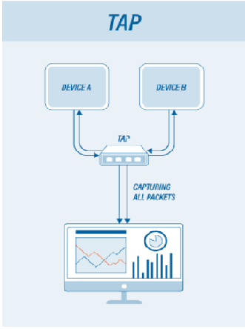
Network tap (Terminal Access Tap):
An alternative solution for long-term monitoring maybe TAP.
This is a hardware device which can passively capture traffic on a network, and is commonly used to monitor the network traffic between two points in the network.
The device can connect and disconnect to the network without disturbing it.
For visibility into the network, a TAP can be placed between the router and the switch.
Network TAPs (1:1 ratio)
Aggregation TAPs (Many:1 ratio)
Regeneration TAPs (1:Many ratio)

Slide 5

ZABBIX
Introduction
Zabbix is an open source distributed monitoring tool including networks, servers, virtual machines and cloud services.
It provides monitoring metrics such as network utilization, CPU load and disk space consumption.
The software monitors operations on Linux, Mac OS X, Solaris and other operating systems.
The Enterprise Class Open Source tool

Slide 6
Features included in Zabbix:
Zabbix uses several options for collecting metrics, including agentless monitoring of user services and client-server architecture. To collect server metrics, it uses a small agent on the monitored client to gather data and send it to zabbix server.
Java management extensions (JMX), web monitoring and other methods are also alternatives to using agents. In Zabbix, JMX can be used to monitor Java-based applications.
Web monitoring is used to check the availability of websites and supports HTTP and HTTPS. Zabbix collects data relating to the average download speed of a scenario, errors and error messages, response time and more.

Slide 7
Components:
It consists of several major components.
Zabbix Server
Central component to which agents report availability and integrity information and statistics.
Database storage
All configuration information as well as the data gathered by Zabbix is stored in a database.
Zabbix Proxy
Collects performance and availability data on behalf of Zabbix server.

Slide 8

Zabbix Agents
They are deployed on monitoring targets to actively monitor local resources and applications and report the gathered data to Zabbix server.
Web Interface
The interface is part of Zabbix server, and usually (but not necessarily) runs on the same physical machine as the one running the server.

Slide 9
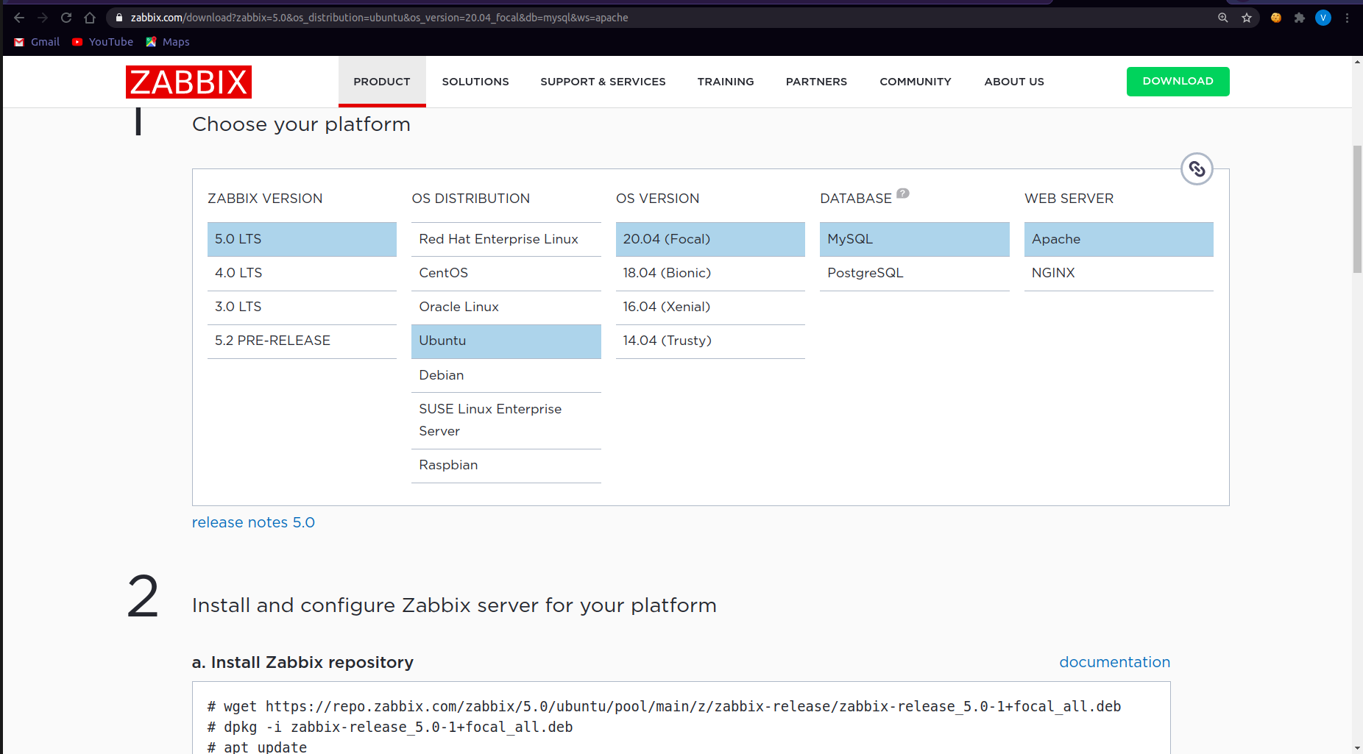
Installation & Configuration
Firstly, go to the zabbix product download page and select the zabbix version and the OS on which it is to be installed.
Choose the database and web server
Get and install the corresponding zabbix repository

Slide 10
Installation & Configuration contd.
Install zabbix server, frontend and agent.
Create a database and user for zabbix.
Grant all permissions of zabbix database to that user.
Configure it with custom password.
Configure PHP for frontend by adjusting the time zone in apache.conf file.
Start the zabbix server and agent using systemctl commands.

Slide 11
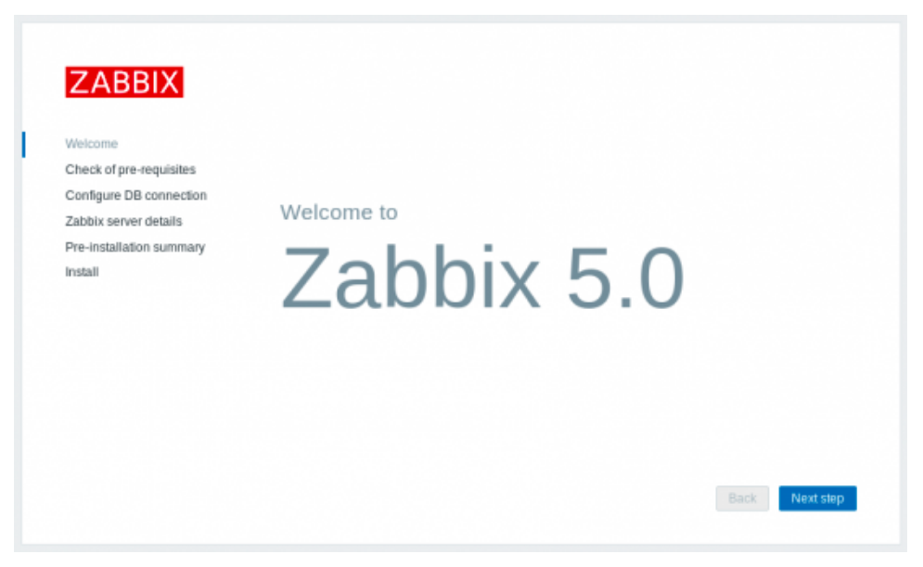
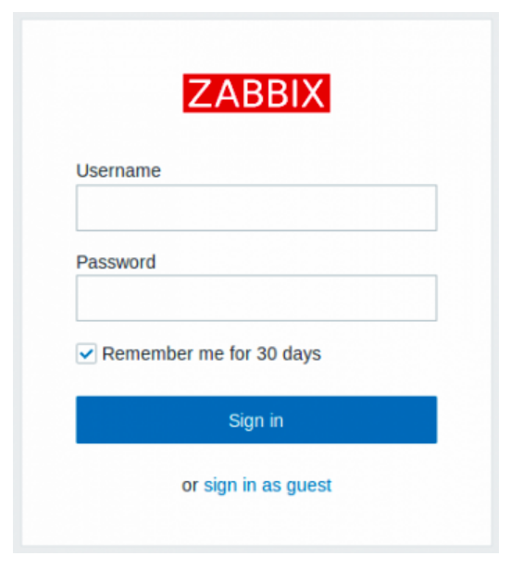
Configuring Zabbix frontend
Connect to frontend on: http://server_ip_or_name/zabbix
Right screen appears on successful server installation.
Enter relevant database and server details.
Login screen appears after finishing configuration.

Slide 12
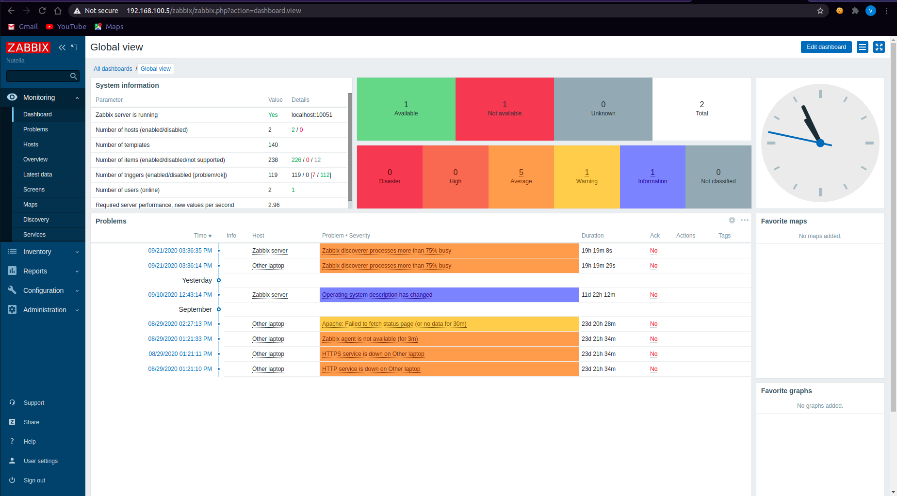
Dashboard appears after login

Slide 13
Working:
The Zabbix web-based GUI enables users to view their IT environment via customizable dashboards based on widgets, graphs, network maps, slideshows and reports.

Slide 14
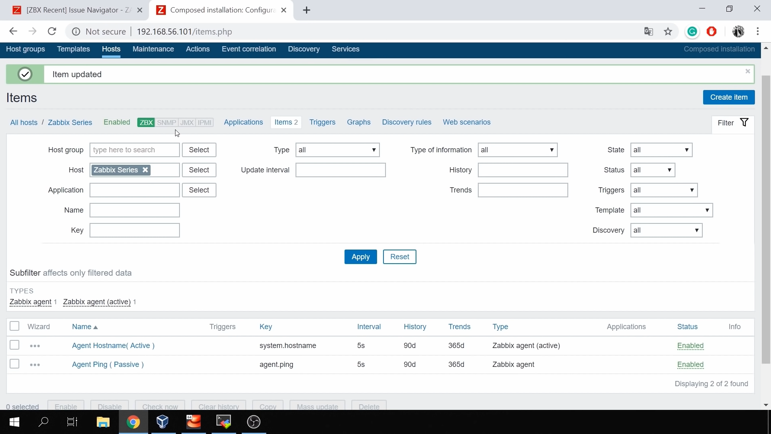
Zabbix works via three discovery mode options:
Network discovery - periodically scans an IT environment and record a device’s type, IP address, status, uptimes and downtimes
Low-level discovery - automatically creates items, triggers and graphs based on the discovered device.
Auto discovery - automatically monitors any discovered device using a Zabbix agent.

Slide 15

Colasoft Capsa
Introduction:
Capsa is the name of the packet analyzer developed by colosoft and there are three editions available.
The tool provides a powerful and comprehensive packet capture and analysis solution.
Traditional Network Analyzers are used to capture packets and analyze.
Portable Network Analyzer and Diagnostics tool

Slide 16
Set-up and Configuration:
There are 3 editions of Capsa available - Capsa Standard Edition, Capsa Enterprise Edition, Capsa Free Edition.
The enterprise edition is the flagship of Colasoft Capsa packet analyzer family, it supports both Ethernet and WLAN. It does real-time packet capturing and analysis as well as past-time events analysis.
The Standard edition is an Ethernet packet analyzer. It does network monitoring, troubleshooting and analyzing.
The free edition is a freeware Ethernet packet analyzer. It is used by network geeks to learn protocols, packets and other network relating knowledge.

Slide 17
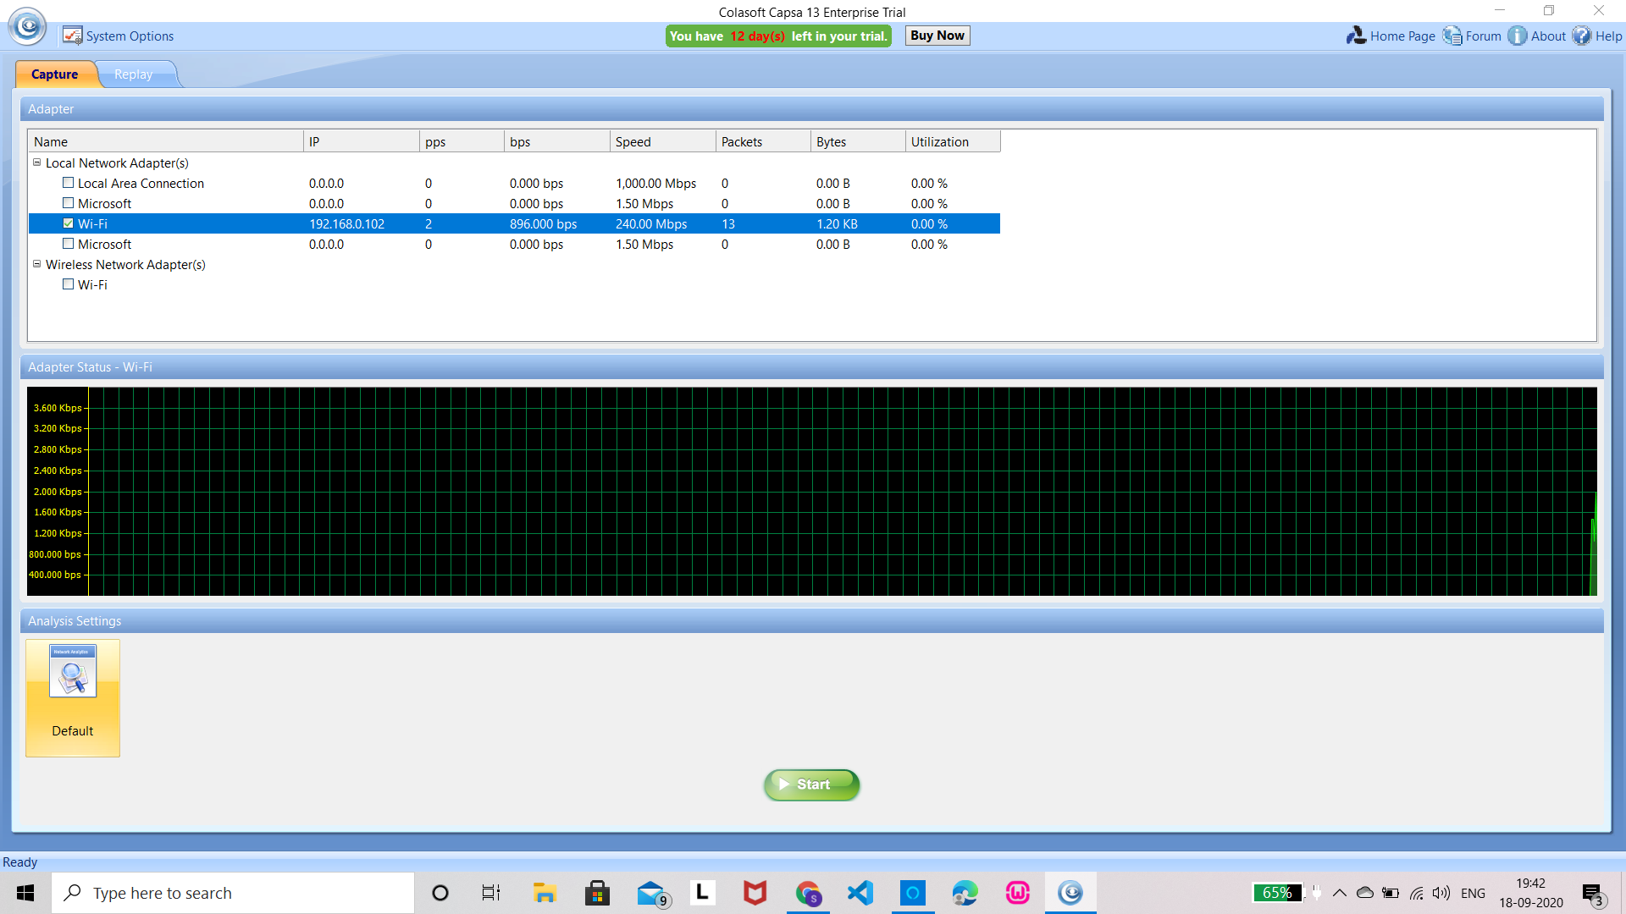
Capsa is a windows based tool. We shall use the enterprise edition and understand the features involved.
The installation and configuration are rather simple compared to other tools
The link below downloads a ‘.exe’. Execute the file and the application is ready to use
https://www.colasoft.com/download/products/download_capsa.php

Slide 18
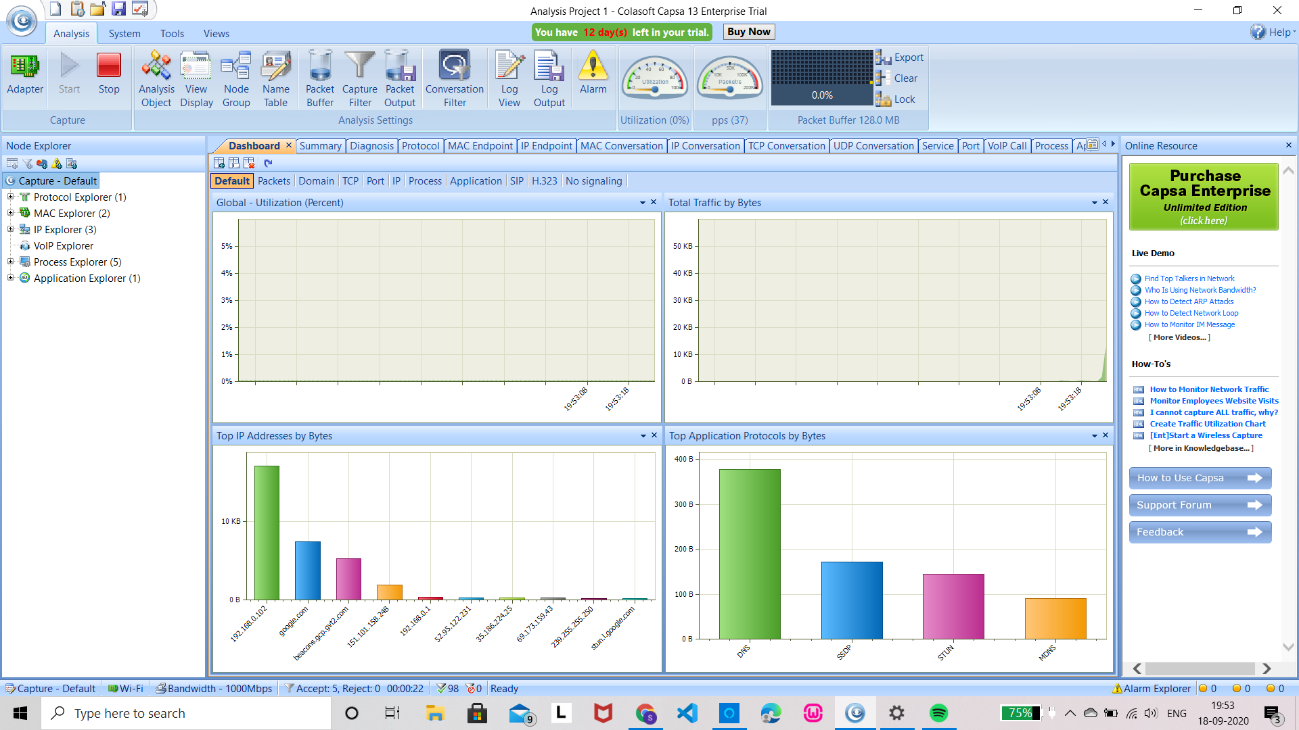
As shown the tool identifies available network adaptors. Select the one we need to monitor and press ‘Start’.
The start and stop buttons on the top left corner are provided to start and stop packet capturing and analysis.
The packets captured can also be saved to the system.

Slide 19
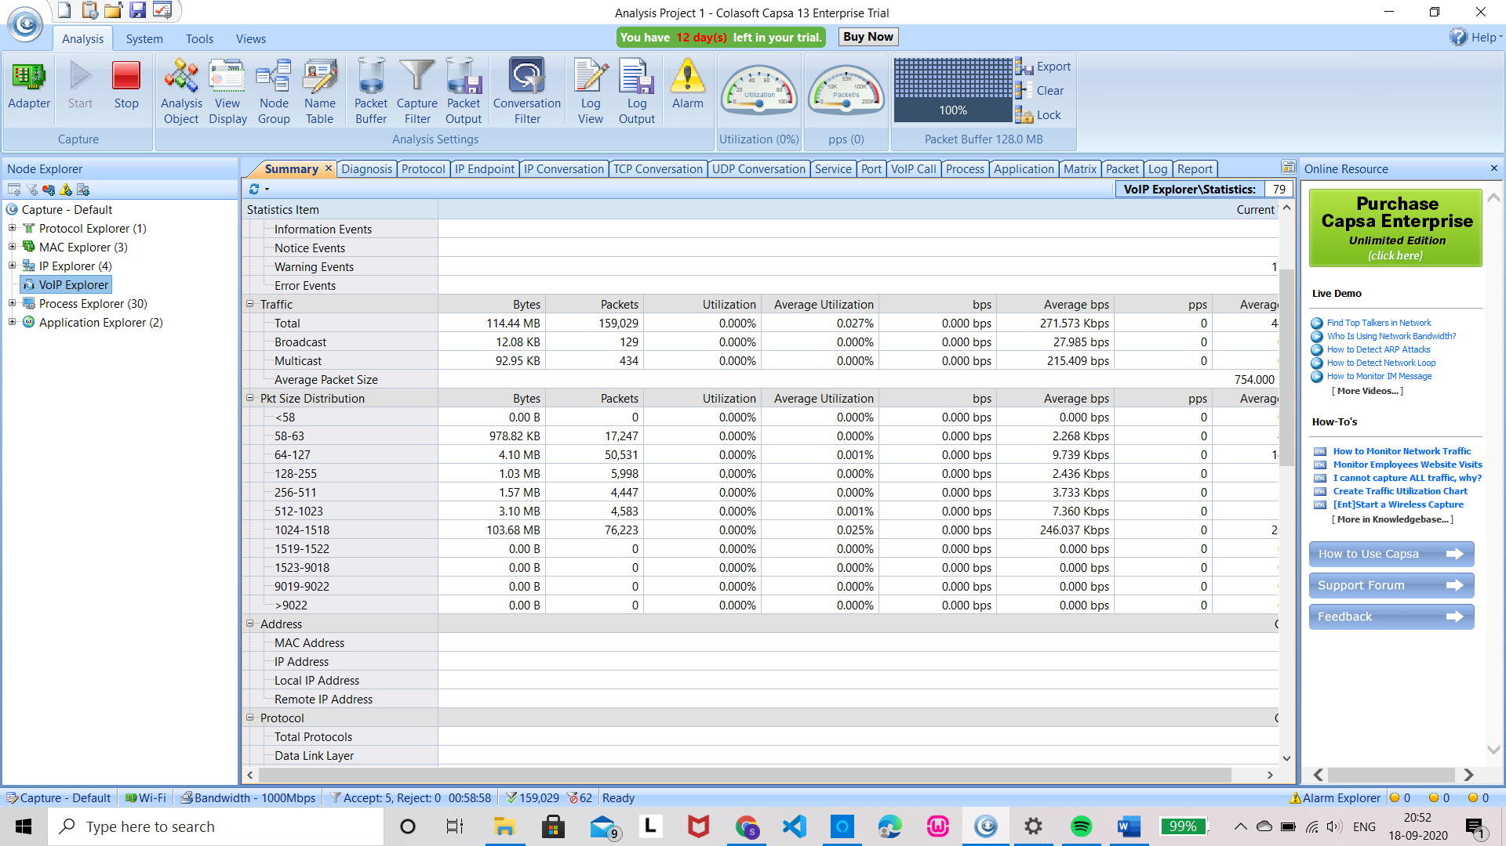
Features:
VoIP Analysis:
Capsa has VoIP(Voice over Internet Protocol) analysis module to capture and analyse VoIP calls and graphically display VoIP analysis results.
VoIP explorer groups all private and public IP addresses for VoIP calls.

Slide 20
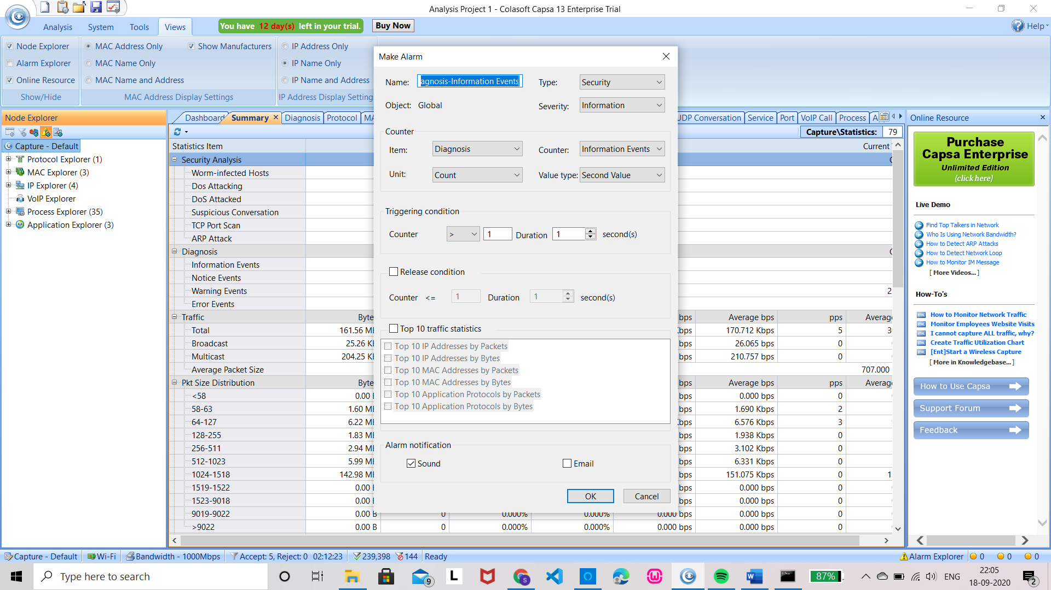
Notifying alarms by Emails & Audio:
We can create alarm rules to watch network anomalies, in case of excessive traffic throughput, excessive broadcast packets, etc
To make an alarm go to Node explorer and select ‘Make Alarm’ under it or directly select ‘Alarm’ under Analysis.

Slide 21
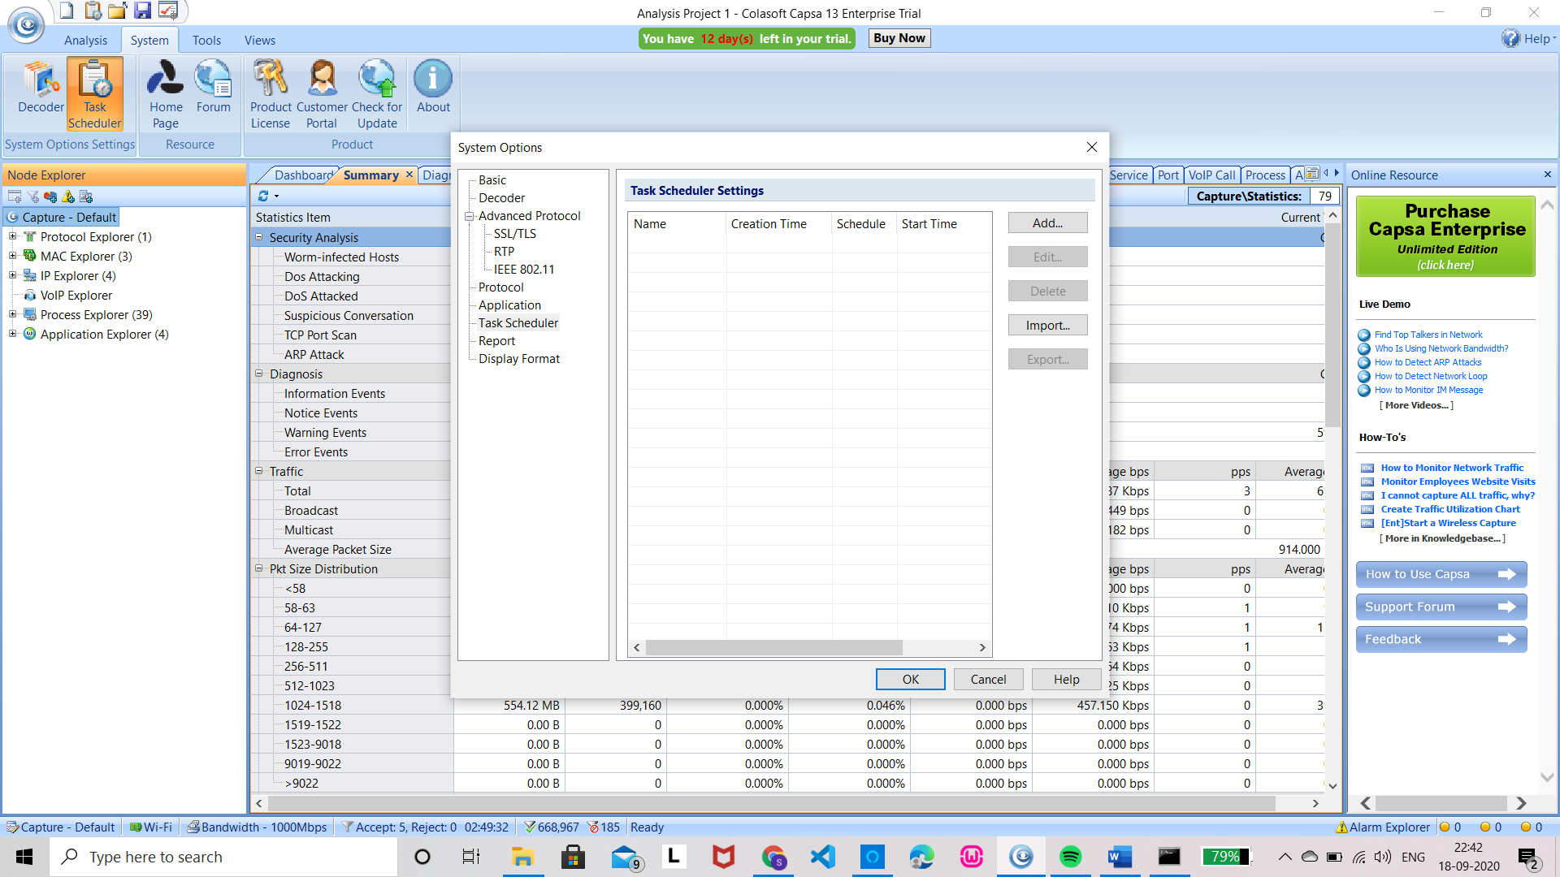
Task scheduler: Auto-run Packet Capture:
Task scheduler provides the ability to run packet capture and analysis at pre-defined automatically, which can be scheduled to run one-time, daily or weekly.
Task scheduler is found under System on the top left corner.

Slide 22
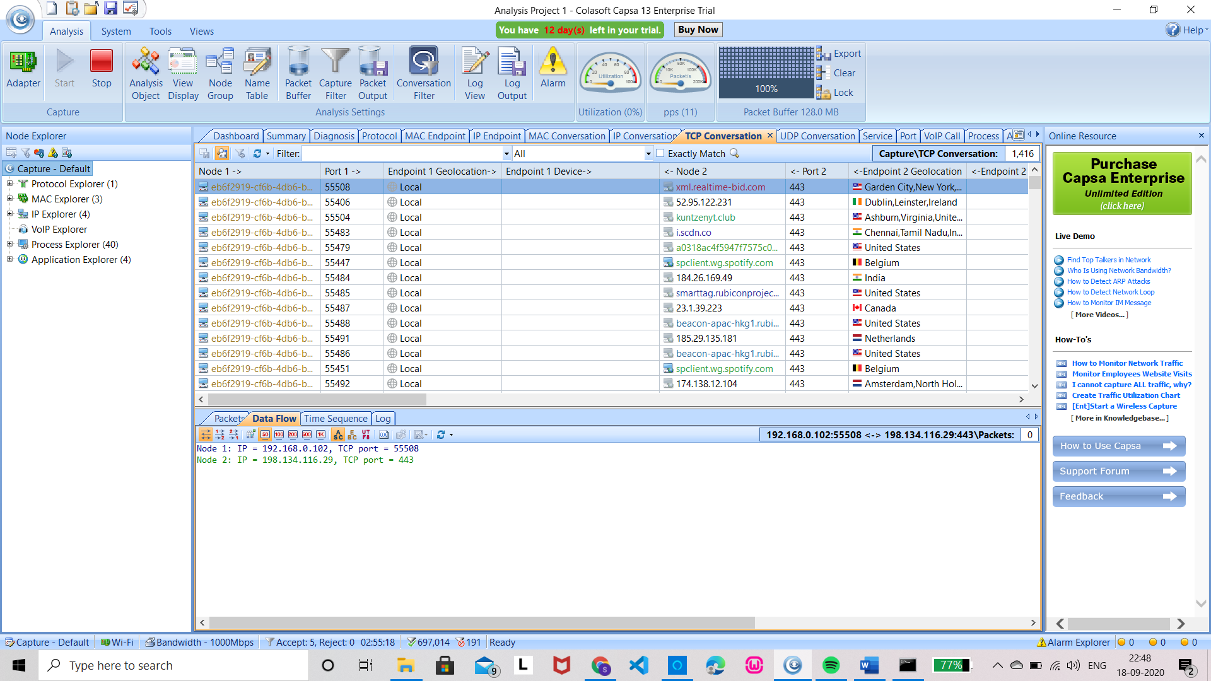
Powerful TCP flow Analysis:
TCP packets give information to help us troubleshoot networks
For example: Slow Network like slow website response, slow CRM transactions and slow downloading or uploading etc.

Slide 23
Extended Network Analysis:
The Capsa Network Analyzer performs traffic statistics as well as Security Analysis. Security Analysis detects the following network anomalies
ARP attack - The malicious source machine can be found by the MAC address
Worm activity - Worms are identified by their network activity and are located with their IP addresses
Dos attack - Capsa detects both compromised machine and machine under Dos attack
TCP port Scanning
Suspicious conversation - Suppose MSN is blocked in our network and HTTP port 80 is open for web browsing. A malicious user could change MSN port to 80 to chat with others.

Slide 24
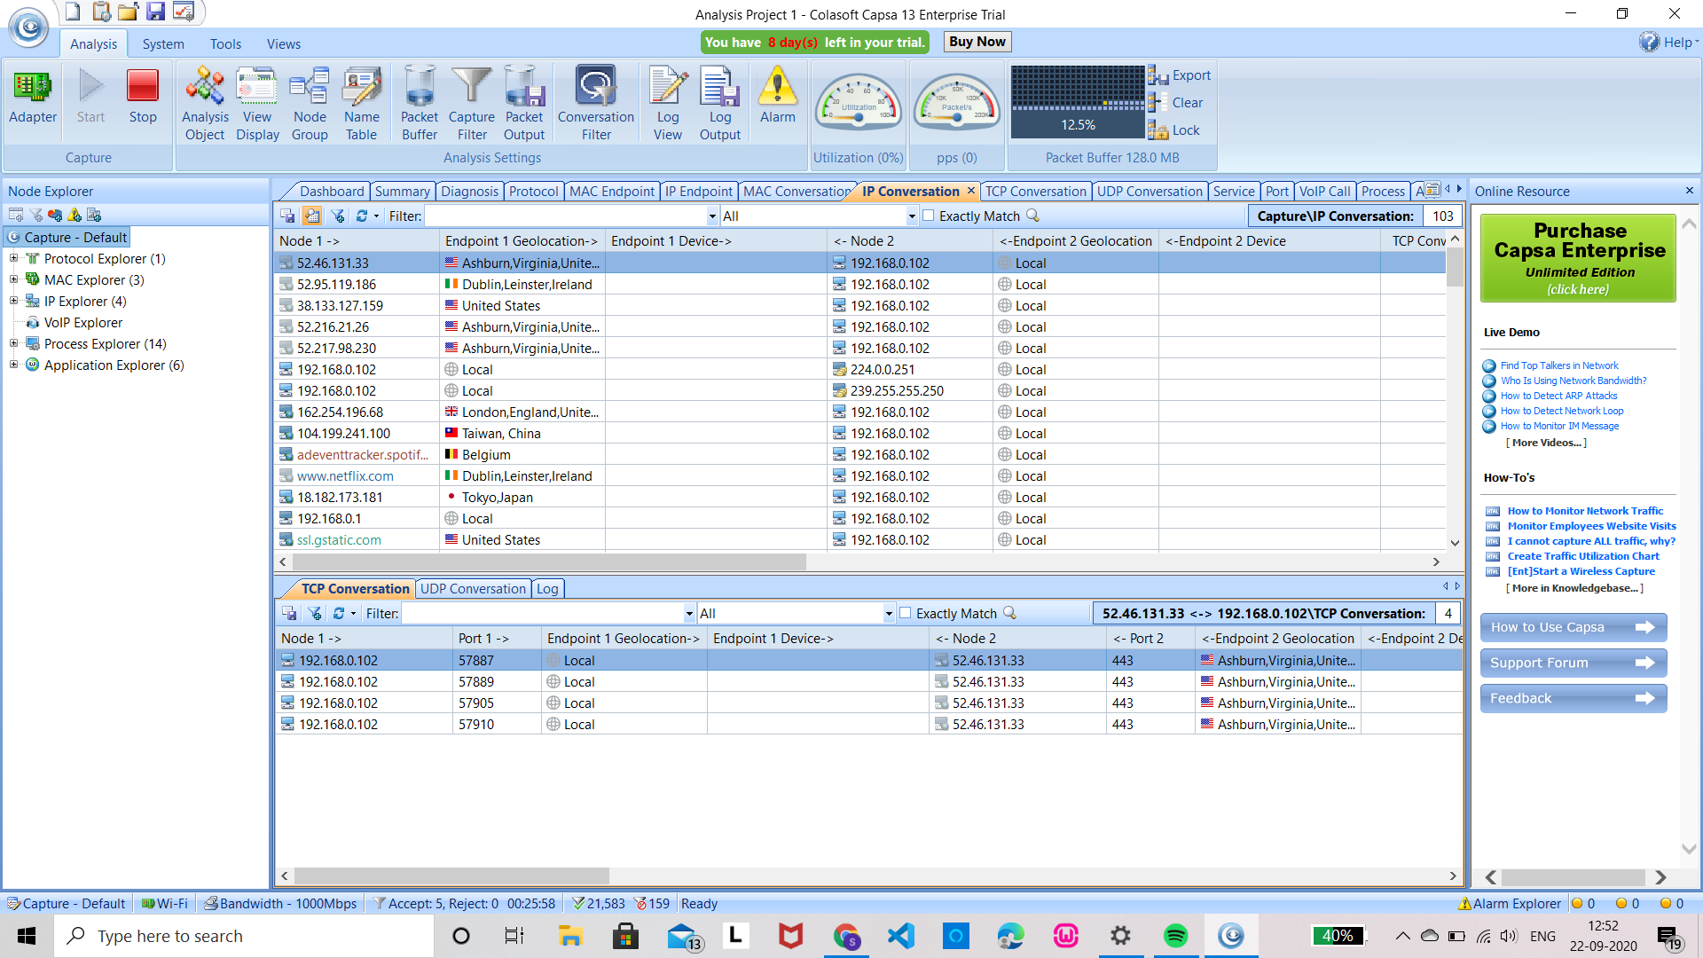
Versatile Traffic and Bandwidth Statistics:
Monitor Network Traffic in the Dashboard tab
Monitor Network traffic in the summary tab
Monitor Network traffic in the physical Endpoint and IP endpoint tabs
Monitor network traffic in the protocol tab
Monitor Network traffic in the conversation tabs
Monitor Network traffic in the Matrix Tab

Slide 25
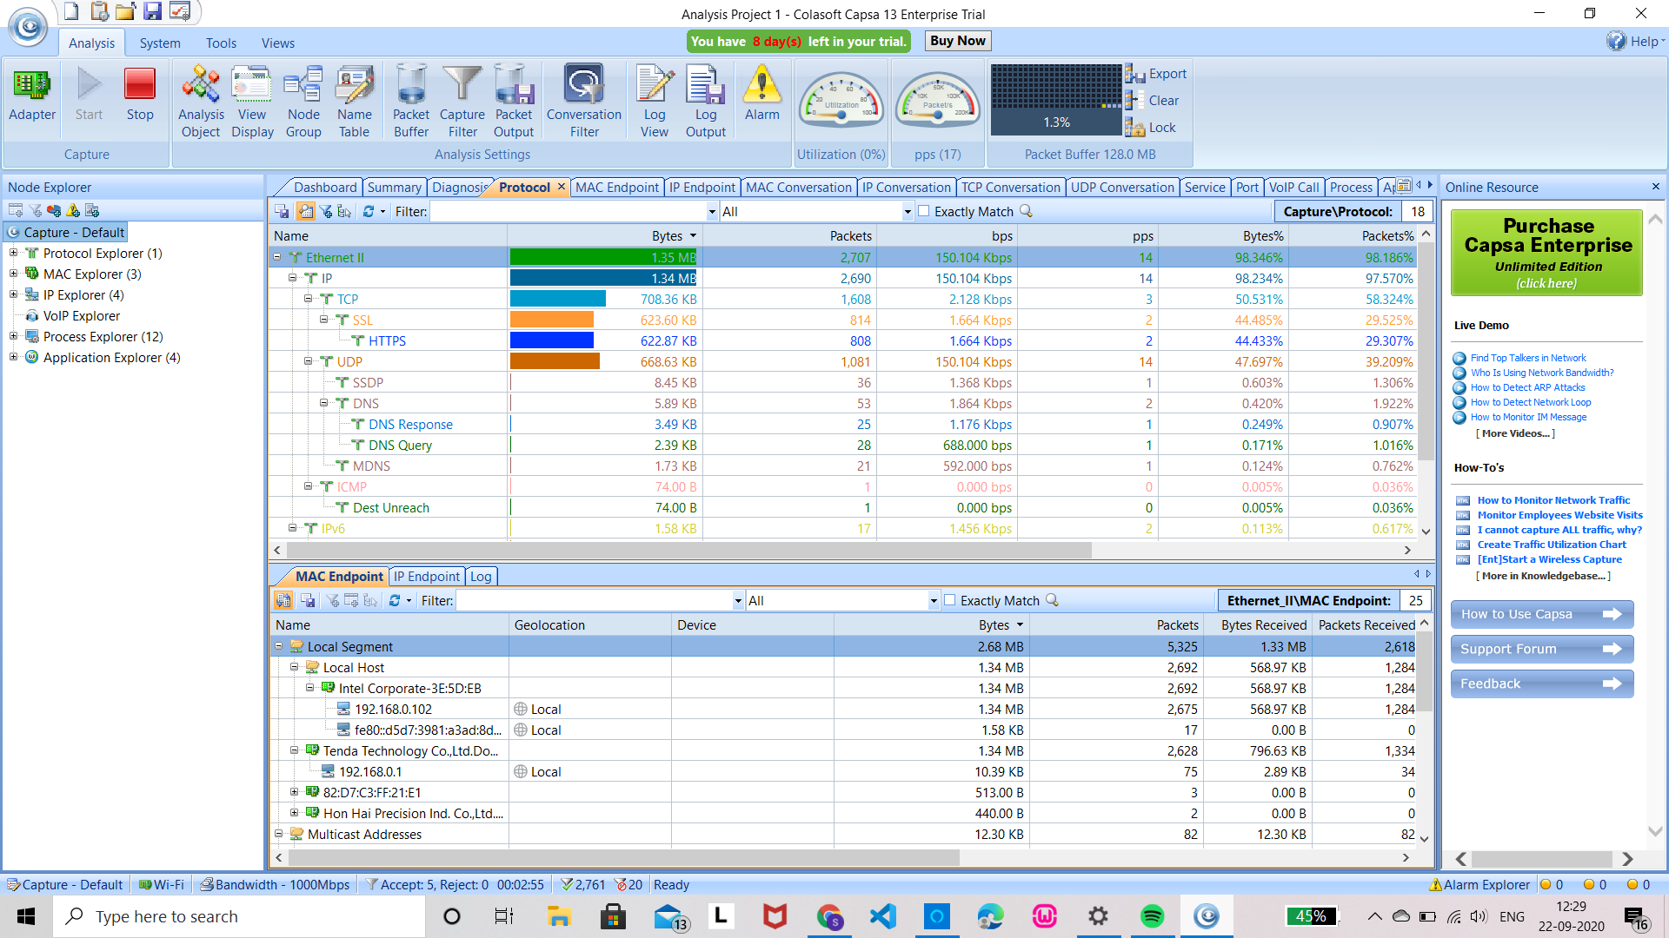
Advanced Network protocol Analysis
Protocol is a convention or standard that controls or enables the connection, communication, and data transfer between two computing endpoints.
Analyze Protocols with Capsa - network application which has generated the largest traffic
Comprehensive Protocol Statistics in the Protocol Tab - protocols detected are listed with detailed traffic

Slide 26
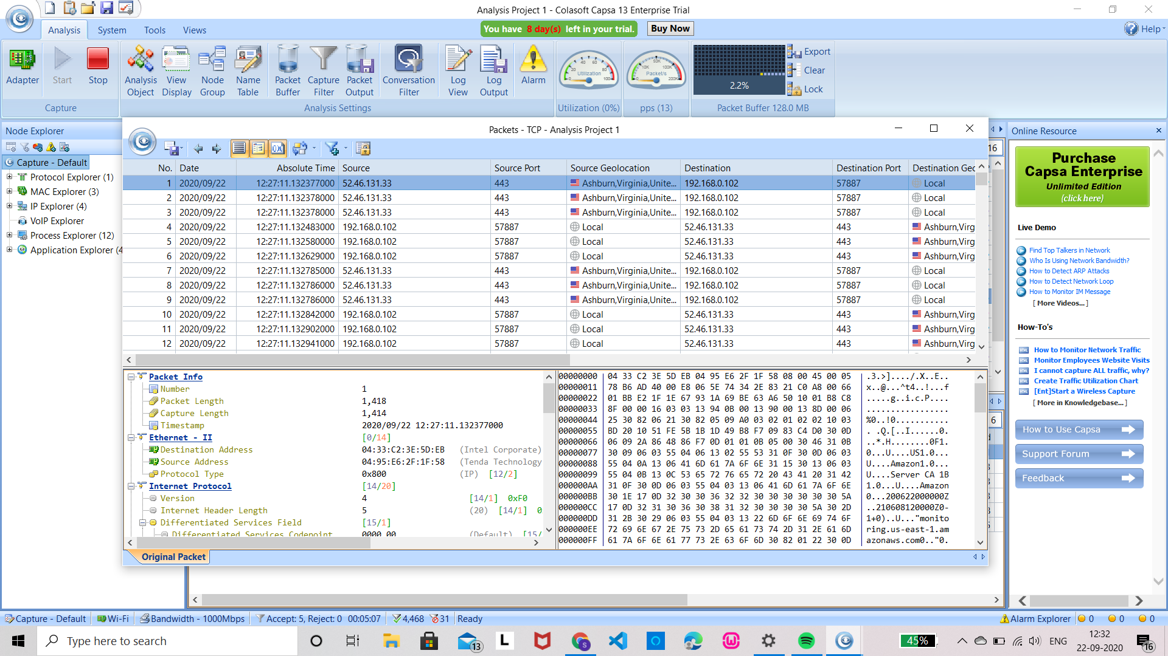
Drilldown on a Single Protocol - Capsa’s Node Explorer window allows network administrators to carry out drill down analysis on a single protocol

Slide 27
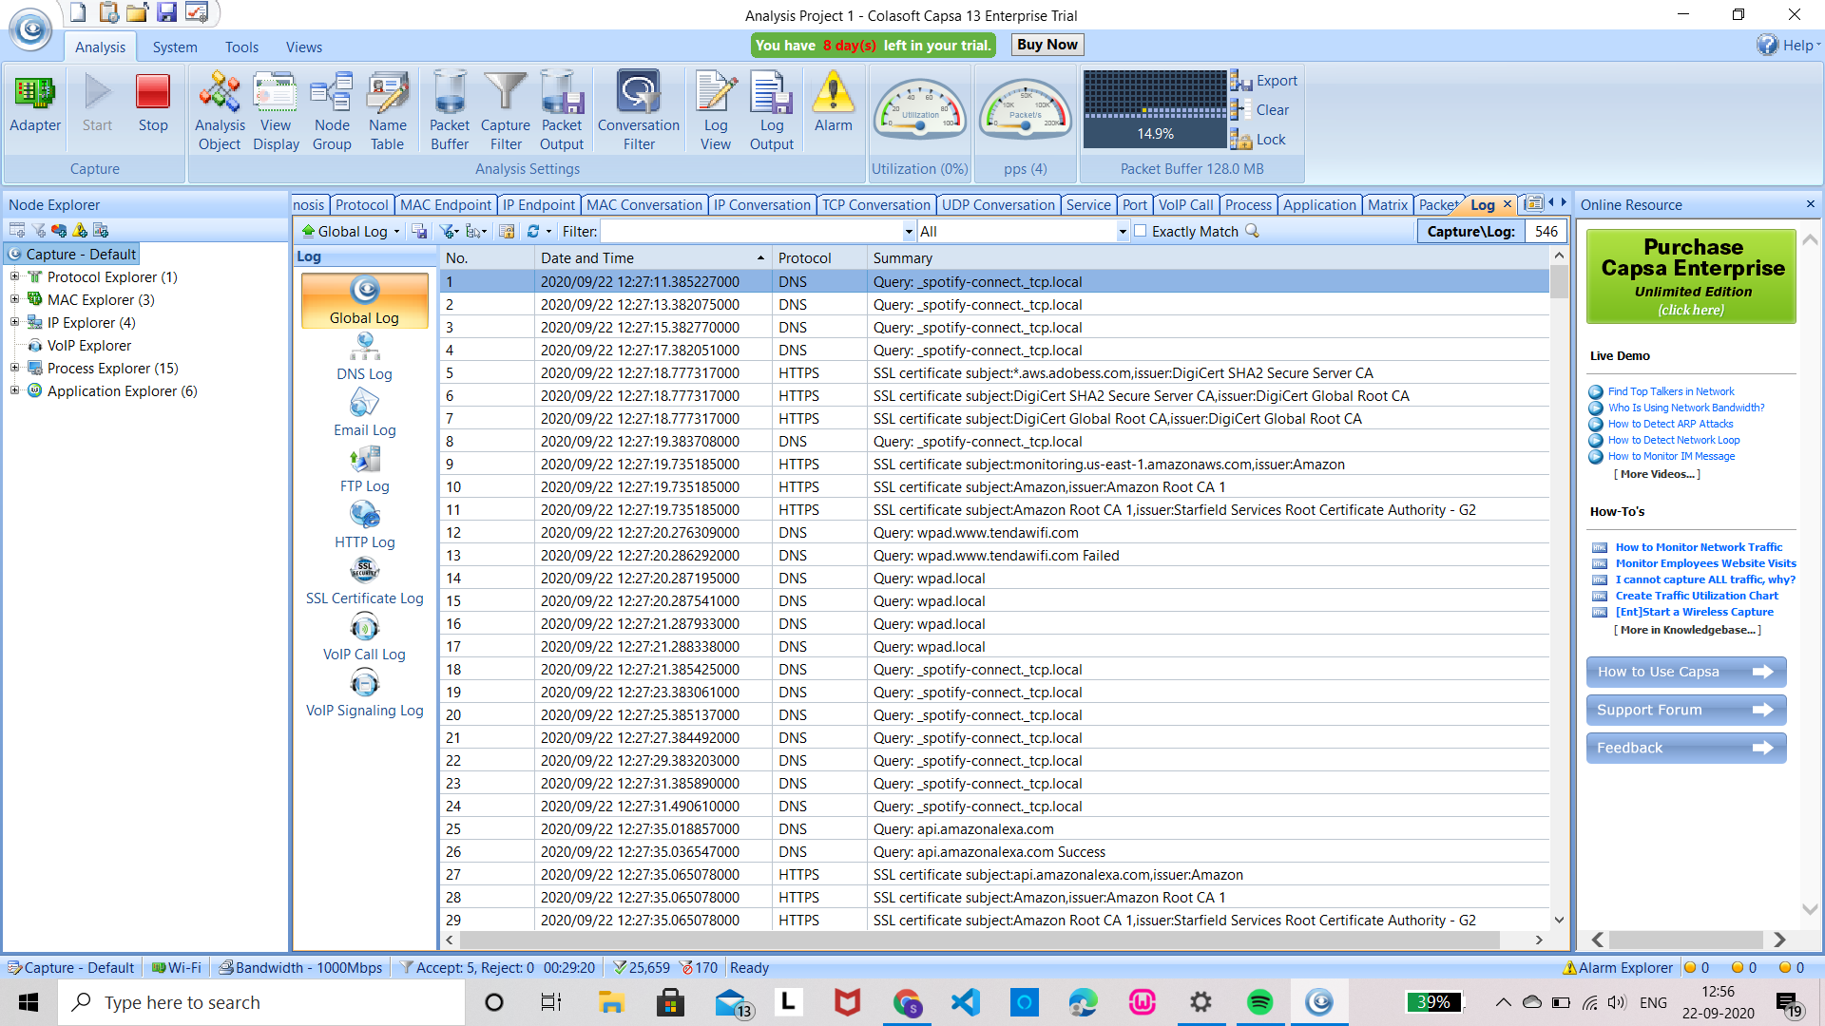
Multiple Network Behaviour Monitoring:
The logs in Colasoft Capsa can record global or scope-specific network events, containing 9 types of log primarily generated by the advanced analyzers: DNS analysis, Email messages, FTP transfers, HTTP webpage visits, VoIP calls, VoIP signalings and activities of 3 instant messengers: ICQ activities, MSN activities and Yahoo Messenger activities.

Slide 28
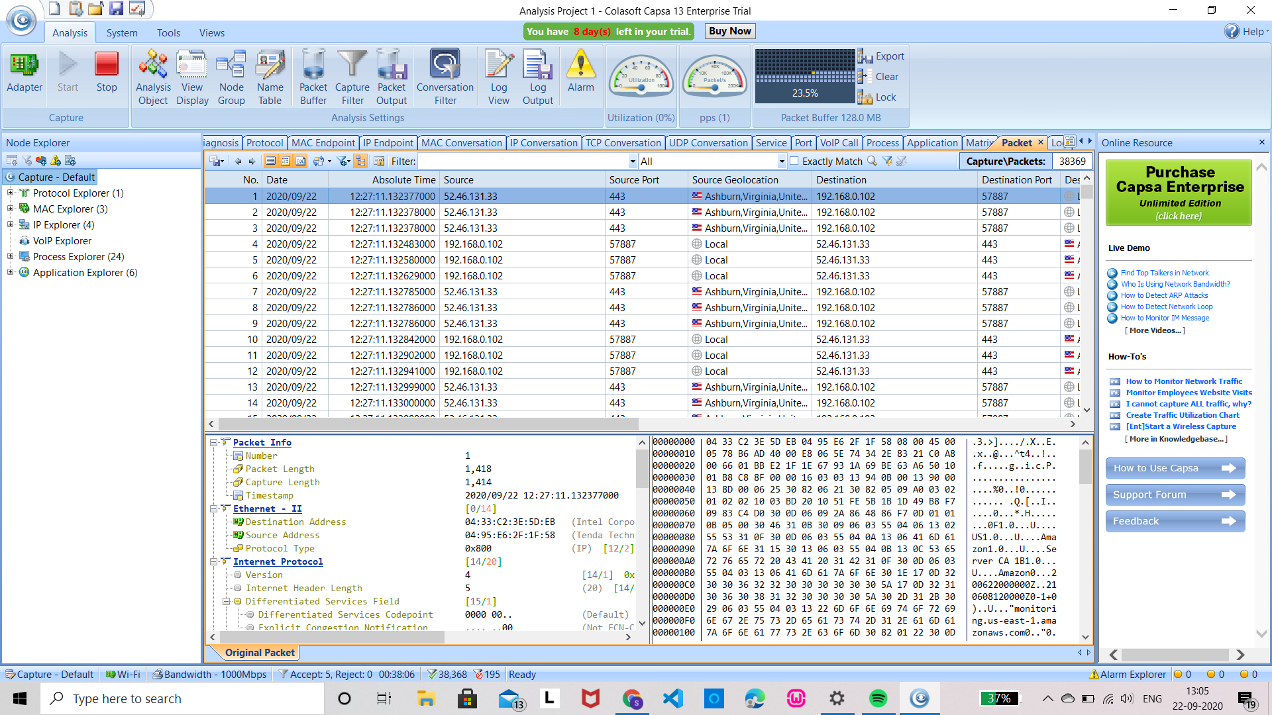
Packet Decoding
Capsa is able to capture all network packets transmitted on network and displays detailed packet decoding information in Hex, ASCII and EBCDIC.
Packet list - table offers the list of packets captured from the node selected in the Node Explorer
Packet decoding information helps troubleshooting network to track down security vulnerability

Slide 29
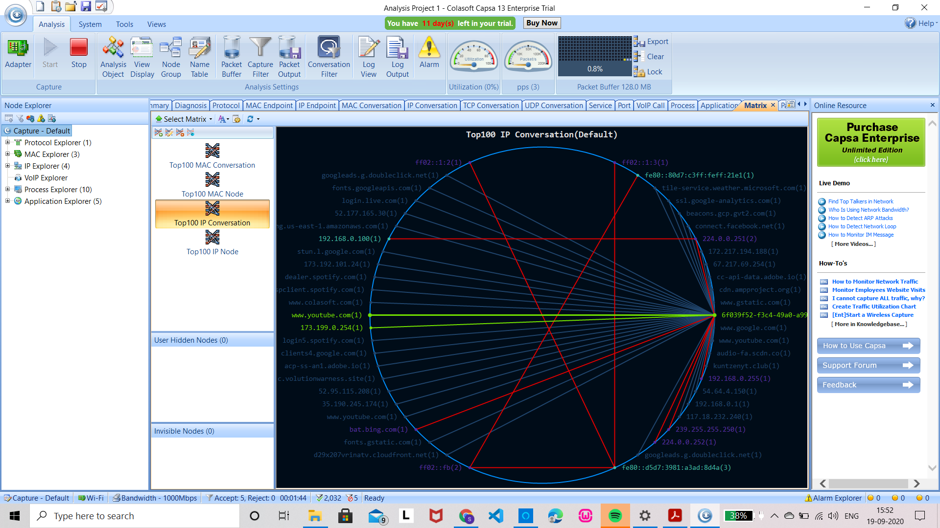
Visualized Connections in Matrix:
The matrix tab visualizes all the network connections and traffic details in a single graph. The nodes around the elongated ellipse display the hosts in the network; the weight of the line between nodes indicates the traffic, and the color indicates status

Slide 30
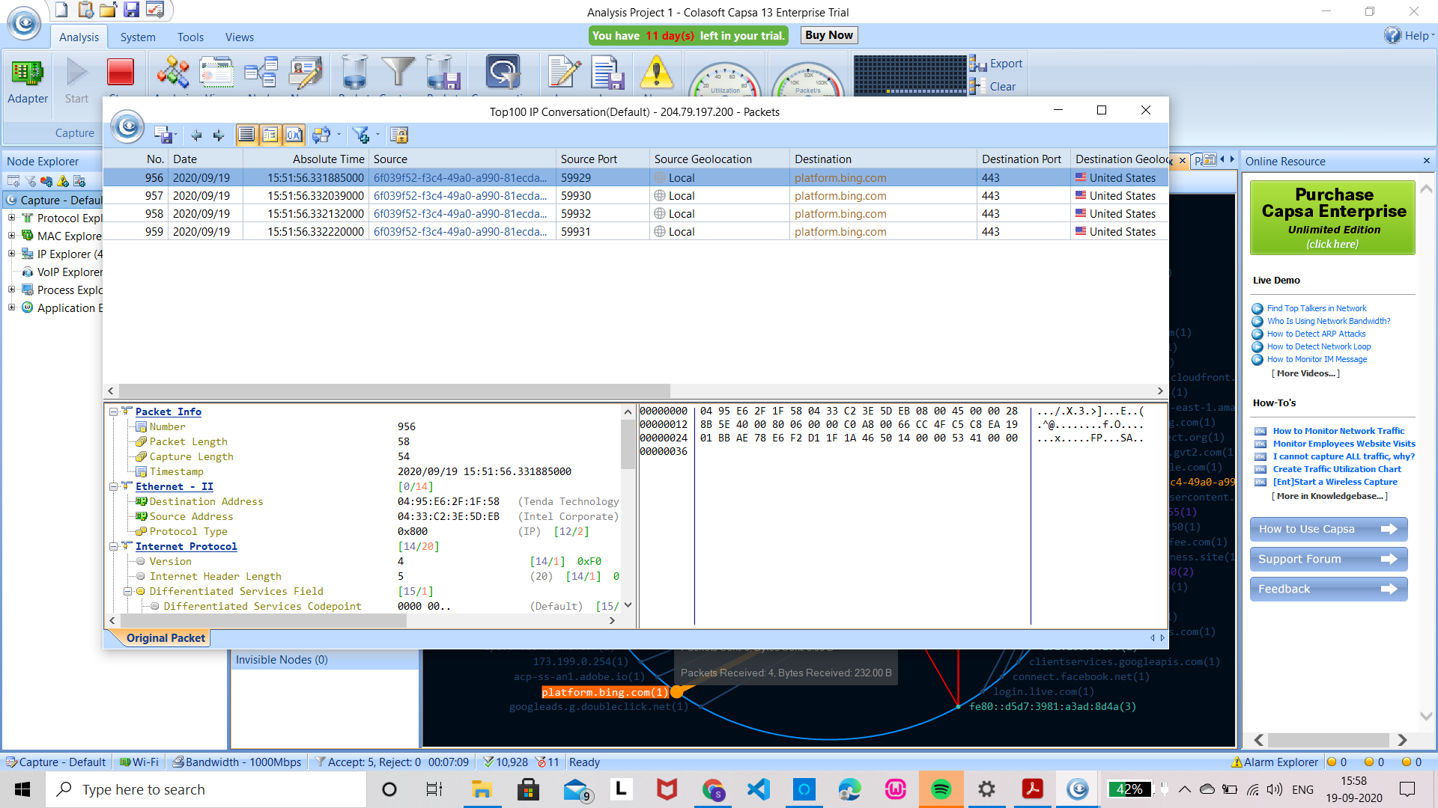
Clicking on a single node, administrators can view its detailed traffic information.

Slide 31
Powerful Conversation Analysis
Useful & Valuable built-in tools
Extensive statistics of each host

